Slide 1

Healthcare Lifeline Session 5:
HC Casing Prep

Slide 2
Agenda
Level set
Mini-case questions
Casing Components
Mock Case

Slide 3
The Recruiting Timeline
 | Sep |  |  |  | Oct |  |  |  | Nov |  |  |  | Dec |  |  |  | Jan |  |  |  | Feb |  |  |  | Mar
FY Students Reach Out
Research Companies
Chat with Second Years
Informational Interviews with Alumni
Company Interactions
Company Presentations
Coffee Chats
Office Hours
Week in Cities
Informational Interviews with Non-Fuquans
Application Process
Resume Development
Cover Letter Development
Interview Prep (Peer, SY, CMC, Alumni)
Resume Drops
Company At-A-Glance Briefs
First Round Interviews (Campus)
Second Round Interviews (HQ)
Higher Intensity
Lower Intensity
We are here
Notes:
Double check dates
Check w/ FuquaConnect and Meg

Slide 4
Level set – purpose of this session
This session will not teach you how to case, we’ll talk about how cases are set up and how to think about them
  For those that have done Roadmap, bear with us while we discuss casing – many of this will be repetitive but we’ll focus on differences in healthcare casing vs. generalist
Highly recommended to work with alumni/SYs/other advocates within the companies to understand how the interview will be structured
If you expect to have a mini case or full case, practice practice practice!

Slide 5
What does interview preparation entail?
Interview Preparation
You
Company
Casing
*meaning prepare your STAR stories, etc.

Slide 6
Why do you need a “Company at a glance sheet”?
Building the document familiarizes you with the company
Consolidate the information you’ve acquired on the company
Review before your interview
Get smart enough on the company you are interviewing with – fast!

Slide 7
Company at a glance sheet basics
What to Include
Information Source
Breakdown of company business units / therapeutic areas / revenue streams
Mission statements / visions
CEO name / history
SWOT analysis
Employees you’ve spoken to
Your questions
Company 10K
Presentation Notes
Informational interviews
Analyst reports
FiercePharma/Biotech News etc.
Company website
Marketline reports through Ford Library https://library.fuqua.duke.edu/databases/index.php

Slide 8
Opportunity for adaption
Include company-customized responses to predicable questions:
  Tell me about yourself?
  Why [DaVita]?
  Why [Provider]?
  Why [Therapeutic Area]?
  Why this [function]?
Strengths & weaknesses

Slide 9
What does interview preparation entail?
Interview Preparation
You
Company
Casing

Slide 10
Agenda
Level set
Mini-case questions
Casing Components
Mock Case

Slide 11
Mini-Case questions – rules of engagement
You never know when you’ll get them
Topic covered are usually (but not always) related to the company you’re interviewing with
Most healthcare cases are mini-cases (they don’t have exhibits and will only take 5 or 10 minutes of the interview.)
Don’t be afraid to take a second and think!

Slide 12
Non consulting companies that may give case questions
DaVita (full case)
Medtronic
J&J
Pfizer
Note: this may not be all inclusive, please talk with SYs or alumni prior to interviewing to understand interview format!!!

Slide 13
Mini-Case Questions Made Easy
1
2
Strategic Situations
Identify the Problem:
“What’s going wrong?”
Generate Solutions:
“We can fix this by…”
1
2
New Product Launch
Identify the Target Population:
“Who and how will we launch?”
Generate Launch Plan:
“We should launch by…”
Solution
1
2
Business Acumen
Optional: Clarify the Situation
“Please help me understand…”
Answer Based on Your Experience:
“I have found the best plan is…”
1
Etc.
Etc.
Market Sizing
Make assumption:
“I’d estimate…”
Make assumption:
“I’d estimate…”
Make assumption:
“I’d estimate…”

Slide 14
“Strategic Solutions” Problems
Strategic Situations
Identify the Problem:
“What’s going wrong?”
Generate Solutions:
“We can fix this by…”
1
2
We currently sell the top drug alluding stent on the market, but a competitor is about to launch a new device with better clinical outcomes. How should we respond?
***More examples in appendix***
Customer
  Patient
  Payer
  Provider
Company
  Biotech v. Pharma
  Salesforce
  Therapeutic Areas
  Unique Competency
Competition
  Rival products
  Adjacencies
  Entry/Exit barriers
  M&A activity
Product
  New indication
  Reduce/Grow Therapy area
Price
  Reimbursement by country
  Sales Chain (PBMs, Payer)
Promotion
  Demographic Preferences
  Trials, samples, etc.
Placement
  Physician Specialty
  Patient Access
Solution

Slide 15
“New Product Launch” Problems
1
2
New Product Launch
Identify the Target Pop:
“Who/how will we launch?”
Generate Launch Plan:
“We should launch by…”
We’re thinking of acquiring a new pharmaceutical product. How should we go about making that decision?
***More examples in appendix***
Segment (generate)
  Geography
  Demographics
  Indication / Health
  Lifestyle
Target (value & select)
  What’s needed to target?
  Which do our competitors like?
  What’s best for us?
Position (strategize)
  Positioning statement with target segment + value proposition
Product
  New indication
  Reduce/Grow Therapy area
Price
  Reimbursement by country
  Sales Chain (PBMs, Payer)
Promotion
  Demographic Preferences
  Trials, samples, etc.
Placement
  Physician Specialty
  Patient Access
Solution

Slide 16
“Business Acumen” Problems
1
2
Business Acumen
Optional: Clarify
“Please help me clarify…”
Use Your Experience:
“I have found that…”
Who would you hire first if you were starting a new company?
***More examples in appendix***
Ask intelligent questions to box-in the problem
  Am I taking over a brand new team?
  Can I assume I have access to all of their documentation?
Make assumptions or statements to shape the question collaboratively
  I assume they are leaving the company entirely
  I assume that I know the product’s general growth strategy
Structure your thoughts to the extent possible
  Well, there’s two sides to a job: interpersonal relationships and technical understanding. In terms of interpersonal, I would ask…
Draw on when you have done, seen, or experienced:
  I had a manager take over a team who failed to ask XYZ – as a result, I think it’s crucial to...
Solution

Slide 17
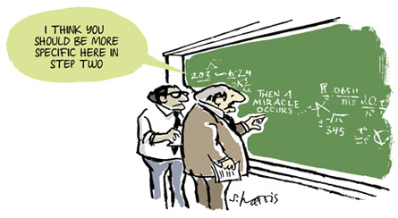
“Market Sizing” Problems
1
Etc.
Etc.
Market Sizing
Make assumption:
“I’d estimate…”
Make assumption:
“I’d estimate…”
Make assumption:
“I’d estimate…”
(Magic?)
How many WSJ subscriptions are there in the US?
How many hospital beds are there in the US?
How many ambulances are there in NYC?
On-the-job example: Estimate the patient population for early-stage lung cancer who is eligible to receive our treatment.
  Verify the number you are looking for (market size vs. quantity sold/used)
  Craft a structure and walk your interviewer through your approach
  THEN, fill in assumptions using logic and your personal experience
  Engage the interviewer and check for cues/feedback
  Stay organized. Do all of your math on a separate sheet!
  Once you get your answer, make meaning of it and provide commentary!
Solution

Slide 18
Agenda
Level set
Mini-case questions
Casing Components
Mock Case

Slide 19
How does HC casing compare to strategy cases?
Similarities | Differences
Goal is to demonstrate strategic thinking Recovering from mistakes well matters Ask questions for clarification, not to solve the problem Generally follows same structure | Industry / company focused, rather than general (usually) → great time to show excitement/passion for and knowledge of healthcare (Typically) less formal/rigid Sometimes formal frameworking isn’t required – be flexible and feel out your interviewer Many companies have a case where you work alone for set time, come back and present

Slide 20
Strong candidates will be:
Poised
Creative
Analytical
Be present (keep eye contact, sit up straight, etc.) Adapt to cues and hints from the interviewer Look excited to be there – this actually can be fun! | Add a unique idea based on your previous experience Show your creative side Don’t be a “robot” | Don’t shy away from numbers Use graphs Show a structured approach to your problem solving
REMEMBER
It’s easy to focus exclusively on the analysis. Poise and
enthusiasm are just as - if not more - important.

Slide 21
1. Prompt/Recap
Your opportunity to show active listening skills and comprehension. You want to pick out the key points of the prompt, and show you understand the main objective of the case.
"So what I'm hearing is …"
Do NOT read back exactly what the interviewer told you. Instead, try to succinctly summarize what you've heard and clearly state the problem.

Slide 22
2. Clarifying Questions
After recapping the prompt, this is your opportunity to ask 1-3 questions about the problem at hand and the structure of the business. A great tool is BGOT:
B – Business Model: How does this company make their money
G – Geography: Where does this company do business currently? Are there plans to change this?
O – Objective: MAKE SURE YOU'RE SUPER CLEAR ON THE GOAL!!!
T – Timeline: When do they want to make the objective happen?

Slide 23
3. Framework
After making sure you're SUPER clear on what it is the case is looking to have you solve, you can usually ask for a few moments (read <2 minutes) to structure potential solutions to the problem.
Frameworks should be super structured, typically in a few "buckets" and help you organize your thoughts into "MECE" or "Mutually Exclusive, Collectively Exhaustive" sections. This means you should try to cover everything you can think of but try not to duplicate ideas.
This may not be part of your healthcare case as they’re typically more like "mini-cases" but it's still good to practice structured thinking.

Slide 24
3. Framework Part 2
Some quick easy "MECE" buckets for you to use
Internal/External
Financial/Non-Financial
Organic/Inorganic Growth
Revenue/Cost/Market
4 P's: Product/Price/Promotion/Place
3 C's: Cost/Company/Competitors

Slide 25
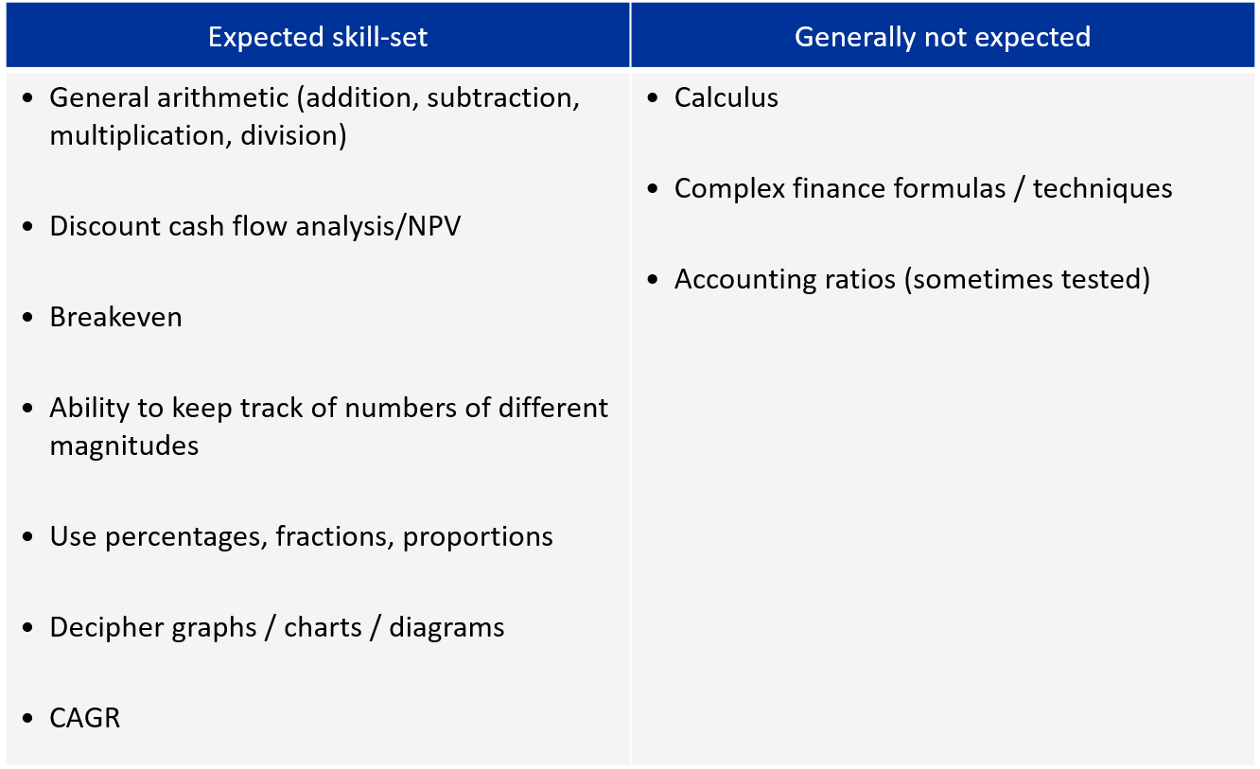
4. Public Math
It doesn’t hurt to make a cheat sheet of formulas or terms to remember!

Slide 26
4. Exhibits
If you get a chart/graph. Pretend that you are the one presenting the information to your interviewer.
Read/Review the information in the following order:
    Top (Title/Headers)
    Left (Axis Titles/Subcategories – sometimes on the bottom)
    Across (Highlights of information provided)
Pull out key insights and use them to get you closer to a solution
Don't forget footnotes!!! - Often where sneaky but really important info hides

Slide 27
5. Brainstorming
Your interviewer may ask you a question like "What risks are associated with this idea?"
Very similar to frameworks but smaller; kind of like mini cases. Your response should be structured and well thought out. Think of this exactly like a framework but with no time to gather all of your thoughts.
It's ok to move back and forth between buckets, just show your thinking clearly.

Slide 28
6. Recommendation
Recommendations can and should be done in 3 parts:
Key recommendation:
    What should they do to solve the case objective?
Risks:
    What might be a concern about following this recommendation?
Next Steps:
    What should they do next? Ideally a way of mitigating the risks just stated I.e. due diligence, market study, etc.

Slide 29
Tips for practicing
If you haven’t gone to roadmap sessions, first try observing your consulting friends do 1 or 2 cases. Roadmap sessions are also recorded and available on Panopto. You can consider watching SY roadmap which is a condensed, 1 day version of Roadmap.
Youtube has a number of case walkthroughs and can be a great way of becoming familiar with casing structure
Try thinking about how you would answer questions you read in the news or during class in a structured way
Practice with friends recruiting for consulting (over winter break too)
  Master 1 or 2 cases that you will ‘give’ for consulting
  In return, ask for and give honest feedback
Do cases until you feel confident and are poised when going through them – likely around 5-10 cases, but different for everyone
Remember: these are written to be solved in a 30-minute interview, meaning they can only be so challenging

Slide 30
Casing practice materials
Practice market sizing materials in appendix
Review Consulting Roadmap slide decks & case books – available on FuquaConnect DMCC page
  Casing workbooks can be found under Documents
  Case books will have a table of contents that often outline the industry of focus (Darden & Kellogg's are particularly good)
Use RocketBlocks.com to practice public math
Marketing Mile – Best place to go for resources & training for market sizing cases
    Marketing Mile session on casing is on November 7th

Slide 31
Mock Case
Your client is a mid-sized pharmaceutical company with an inhaled insulin product for the diabetes market. The client’s goal is to earn peak revenues of $300M/year in the U.S. and they have asked you to determine whether this sales goal is realistic by calculating the dollar value of the current insulin market and determining which factors will influence the success of the product.

Slide 32
What components do you need to know to determine the market size of this product?
In order to determine the market size for your client, you must know the following pieces of information:
Prevalence of the Disease in the U.S.
Disease Segmentation
Diagnosis Rate
Treatment Rate
Pricing

Slide 33
After researching the insulin market, the following information was found.
The prevalence of diabetes in the U.S. is approximately 20 M patients.
Type I diabetes comprises 10% of the prevalent patient population, while the other 90% is comprised of patients with Type II diabetes.
Of this affected population, nearly 100% of Type I patients are diagnosed, while only 65% of Type II patients are diagnosed.
Furthermore, while 100% of Type I patients are treated with insulin, only approximately one-third of Type II patients are treated due to a variety of factors.
Lastly, while the price and dose of insulin varies, your research has indicated that, on average, insulin therapy costs $80/month per patient. Your client has also indicated that pricing for the product they are developing would be in line with this.

Slide 34
Mock Case
Using this information, determine the current insulin market size and the percentage capture the client must achieve in order to reach their peak sales goal of $300 M/year.
Prevalence of the Disease in the U.S.: 20 M patients
Disease Segmentation
  Type I: (20 M patients)*(.10) = 2 M patients
  Type II: (20 M patients)*(.90) = 18 M patients
Effect of Diagnosis Rate on Prevalent Patient Population
  Type I: (2 M patients)*(1) = 2 M diagnosed patients
  Type II: (18 M patients)*(0.65) = 12 M diagnosed patients
  Total: 14 M diagnosed patients
Effect of Treatment Rate on Diagnosed Prevalent Patient Population
  Type I: (2 M patients)*(1) = 2 M treated patients
  Type II: (12 M patients)*(1/3) = 4 M treated patients
  Total: 6 M treated patients
Pricing and Revenue
  ($80 month/patient)*(12 months) = ~$1,000 year/patient
  ($1,000 year/patient)*(6 M treated patients) = $6 B/year
Market Capture
  ($300 M/year peak revenue goal)/($6 B/year total market size) = 5% capture

Slide 35
Mock Case
In order to evaluate how realistic a 5% market penetration is for your client, what factors regarding the inhaled insulin product do you need to consider and how can each of them affect the success of the product?
There are many factors that can affect the success of your client’s product, however some of the key considerations are:
Efficacy
Safety
Convenience
Price
Onset of Action
Biologic Variability
Research into the first four areas revealed that the drug is indeed as efficacious as predicted in both short and long-term scenarios. Furthermore, the drug demonstrated strong tolerability and safety on a short-term scale, but long-term data was found to be lacking, particularly relative to injectable insulin which has had a long track record in the clinic. Lastly, while the price is comparable to current therapies on the market, the convenience of the product was limited due to the inhaler not being considered travel size by patients.

Slide 36
Mock Case
Considering all of the above information, do you feel that the client will be able to capture the 5% of the market they need to reach their current peak revenue sales goal? Why or why not?
Ultimately, the research indicated that 5% market share was unlikely. Given the fact that the product did not improve upon efficacy or safety, the lack of convenience and lack of long-term safety data (relative to injectable insulin) was expected to severely limit use of the product.

Slide 37
GOOD LUCK!
Let us know if we can help with anything ☺

Slide 38
Appendix:

Slide 39
Market Sizing Question 1
Your client is a major manufacturer of specialty dental materials (e.g., fillings, dentures, etc.). Your team is conducting a strategic review of their various product lines. Your manager has asked you to size the worldwide market for tooth filling materials (i.e. fillings made from silver, composite, ceramic or other materials).
Sources: Rocketblocks, https://www.globenewswire.com/news-release/2016/11/07/887276/0/en/Tooth-Filling-Materials-Market-size-to-exceed-1-4bn-by-2024-Global-Market-Insights-Inc.html

Slide 40
Market Sizing Question 1 Potential Response
Type | Description | Value(s)
Assumption | Global population | 7.5B
Assumption | Relevant population is everyone in 1) developed and 2) less developed markets | n/a
Assumption | Percent living in developed countries (%) Percent living in less developed countries (%) Percent living in undeveloped countries (%) | 20% 40% 40%
Calculation | People in developed markets: 7.5B * 20% in developed People in less developed markets: 7.5B * 40% less developed | 1.5B 3.0B
Assumption | Developed country dentist visit rates, percent who go annually (%) Less developed country dentist visit rates, percent who go annually (%) | 25% 10%
Assumption | Dental filling is needed once in every X years (for people who visit) | 10
Calculation | Developed market annual fillings: 1.5B * 25% * 1/10 Less developed market annual fillings: 3B * 10% * 1/10 | 37.5M 30M
Assumption | Average price of fillings materials | $20.00
Calculation | Total market for dental fillings materials: (37.5M + 30M) * $20 per filling | $1.35B

Slide 41
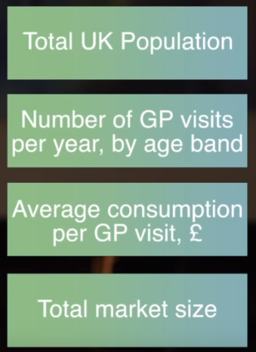
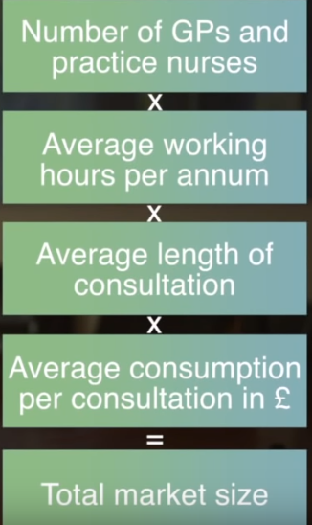
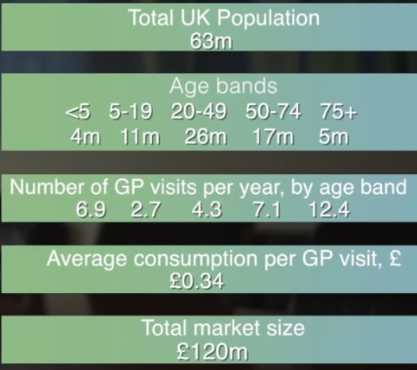
Market Sizing Question 2
Question: Calculate the market size for medical consumables in GP practices in the UK
Top Down Approach
Bottom Up Approach

Slide 42
“Strategic Solutions” Problems
Strategic Situations
Identify the Problem:
“What’s going wrong?”
Generate Solutions:
“We can fix this by…”
1
2
We currently sell the top drug alluding stent on the market, but a competitor is about to launch a new device with better clinical outcomes. How should we respond?
We have a brand that’s doing well in Germany but suffering in the US. How should we fix this situation?
An organization has recently merged and your CEO has asked you to deliver $10MM in savings within the next 3 months. How would you do this??
Customer
  Patient
  Payer
  Provider
Company
  Biotech v. Pharma
  Salesforce
  Therapeutic Areas
  Unique Competency
Competition
  Rival products
  Adjacencies
  Entry/Exit barriers
  M&A activity
Product
  New indication
  Reduce/Grow Therapy area
Price
  Reimbursement by country
  Sales Chain (PBMs, Payer)
Promotion
  Demographic Preferences
  Trials, samples, etc.
Placement
  Physician Specialty
  Patient Access
Solution

Slide 43
“New Product Launch” Problems
1
2
New Product Launch
Identify the Target Pop:
“Who/how will we launch?”
Generate Launch Plan:
“We should launch by…”
We’re thinking of acquiring a new pharmaceutical product. How should we go about making that decision?
How would you go about creating a commercialization plan for a new drug?
How would you think about pricing a new drug?
Segment (generate)
  Geography
  Demographics
  Indication / Health
  Lifestyle
Target (value & select)
  What’s needed to target?
  Which do our competitors like?
  What’s best for us?
Position (strategize)
  Positioning statement with target segment + value proposition
Product
  New indication
  Reduce/Grow Therapy area
Price
  Reimbursement by country
  Sales Chain (PBMs, Payer)
Promotion
  Demographic Preferences
  Trials, samples, etc.
Placement
  Physician Specialty
  Patient Access
Solution

Slide 44
“Business Acumen” Problems
1
2
Business Acumen
Optional: Clarify
“Please help me clarify…”
Use Your Experience:
“I have found that…”
Who would you hire first if you were starting a new company?
You are about to be the new marketing manager for a product, and you have 30 minutes to ask questions of the old marketing manager. What do you ask?
Ask intelligent questions to box-in the problem
  Am I taking over a brand new team?
  Can I assume I have access to all of their documentation?
Make assumptions or statements to shape the question collaboratively
  I assume they are leaving the company entirely
  I assume that I know the product’s general growth strategy
Structure your thoughts to the extent possible
  Well, there’s two sides to a job: interpersonal relationships and technical understanding. In terms of interpersonal, I would ask…
Draw on when you have done, seen, or experienced:
  I had a manager take over a team who failed to ask XYZ – as a result, I think it’s crucial to...
Solution

Slide 45
“Market Sizing” Problems
1
Etc.
Etc.
Market Sizing
Make assumption:
“I’d estimate…”
Make assumption:
“I’d estimate…”
Make assumption:
“I’d estimate…”
(Magic?)
How many WSJ subscriptions are there in the US?
How many hospital beds are there in the US?
How many ambulances are there in NYC?
How many airplanes are above the US right now?
  Verify the number you are looking for (market size vs. quantity sold/used)
  Craft a structure and walk your interviewer through your approach
  THEN, fill in assumptions using logic and your personal experience
  Engage the interviewer and check for cues/feedback
  Stay organized. Do all of your math on a separate sheet!
  Once you get your answer, make meaning of it and provide commentary!
Solution

